Slide 1





WIRED 2024
MNE-Python Tutorial
March 13, 2024
9:30am – 12:30pm
Paris, France
Maansi Desai, PhD
Postdoctoral Fellow
UT Austin
Alexandre Gramfort, PhD
Senior Research Scientist
Meta Inc.
Apolline Mellot
PhD Candidate
Univ. Paris-Saclay

Slide 2
WHO ARE WE?
Maansi Desai, PhD
Alexandre Gramfort, PhD
Apolline Mellot
Postdoctoral Fellow
UT Austin
Senior Research Scientist
Meta Inc.
PhD Candidate
Univ. Paris-Saclay

Slide 3
AGENDA
Preprocessing and plotted evoked intracranial EEG (Maansi)
MEG/EEG data preprocessing and analysis (Alexandre/Apolline)
WIRED 2024

Slide 4
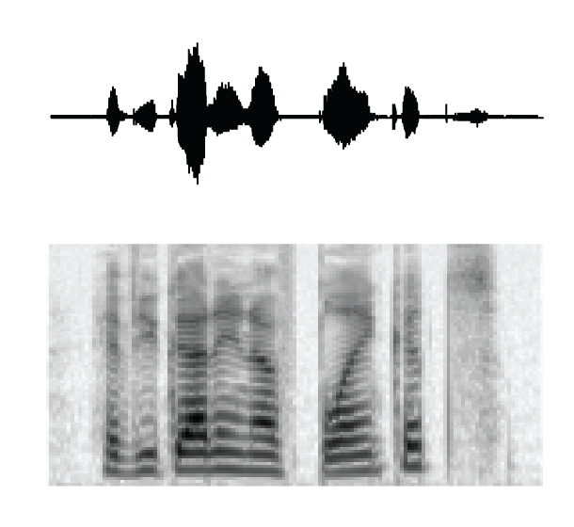
sentence
Have you got enough blankets?
meaning
word
hɪv y gɑɾ ɪn ʌf blæŋ kᵼts
syllable
hɪvygɑɾɪnʌfblæŋkᵼts
phoneme
spectrotemporal
(frequency decomposition)
acoustic vibration

Slide 5
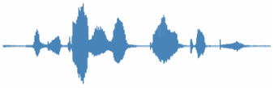
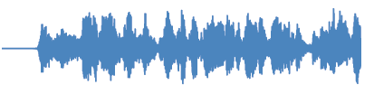
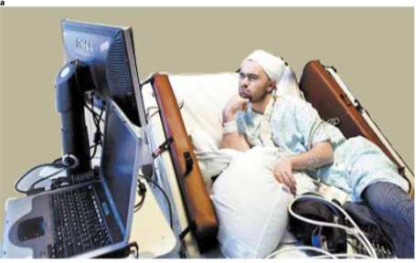
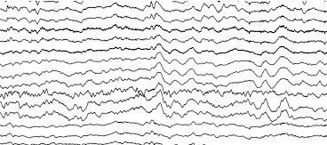
INTRACRANIAL RECORDINGS IN THE HOSPITAL
Miller Nature Human Behavior 2019
Intracranial recordings + cognitive tasks for research
WIRED 2024

Slide 6
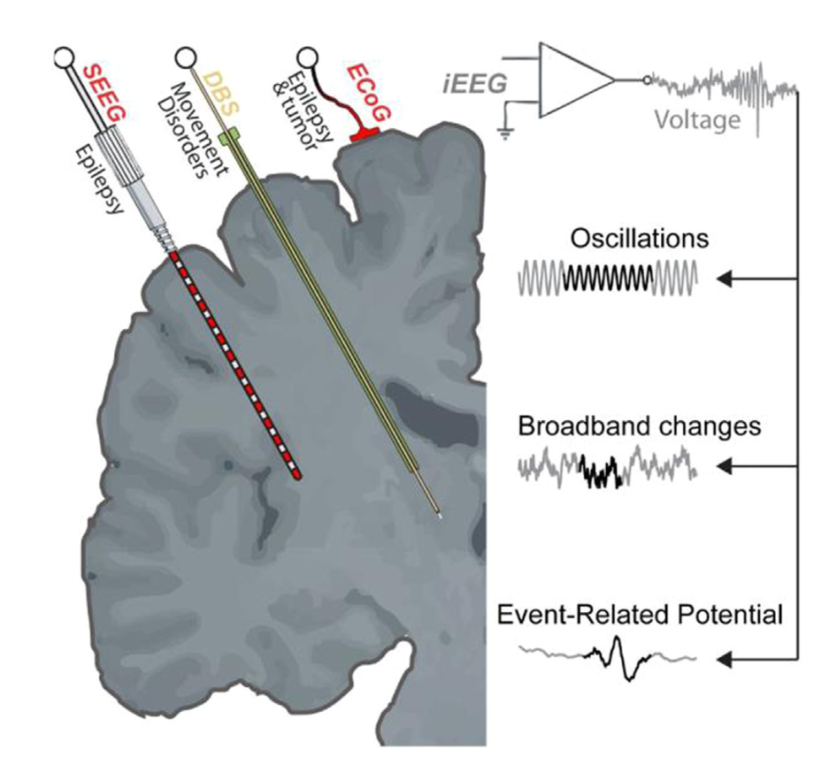
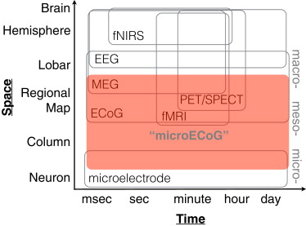
HOW DO SIGNALS DIFFER?
Chang et al. Neuron 2015
Mercier et al. NeuroImage 2022
WIRED 2024

Slide 7
HIGH GAMMA AS AN INDEX OF NEURAL ACTIVITY
”It had gone like clockwork”
Stimuli from TIMIT
(Garfolo et al. 1993)
“high
gamma”
correlated with multi-unit spiking
(Ray & Maunsell, PLoS Biology 2011)
WIRED 2024

Slide 8
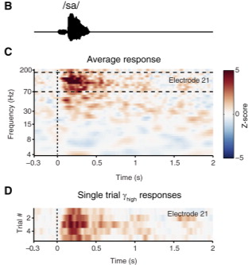
ADVANTAGES OF INTRACRANIAL RECORDINGS
Can measure changes at fast timescales
Phonological information: /b/ vs. /p/
You know where your signals are coming from
Very high SNR, requires fewer trials than EEG/MEG
WIRED 2024

Slide 9
DISADVANTAGES OF INTRACRANIAL RECORDINGS
Coverage depends on clinical need, not your research question
Invasive (must be done in patient populations)
Epilepsy/tumor
Relatively time-limited experiments / less controlled experiments
WIRED 2024

Slide 10
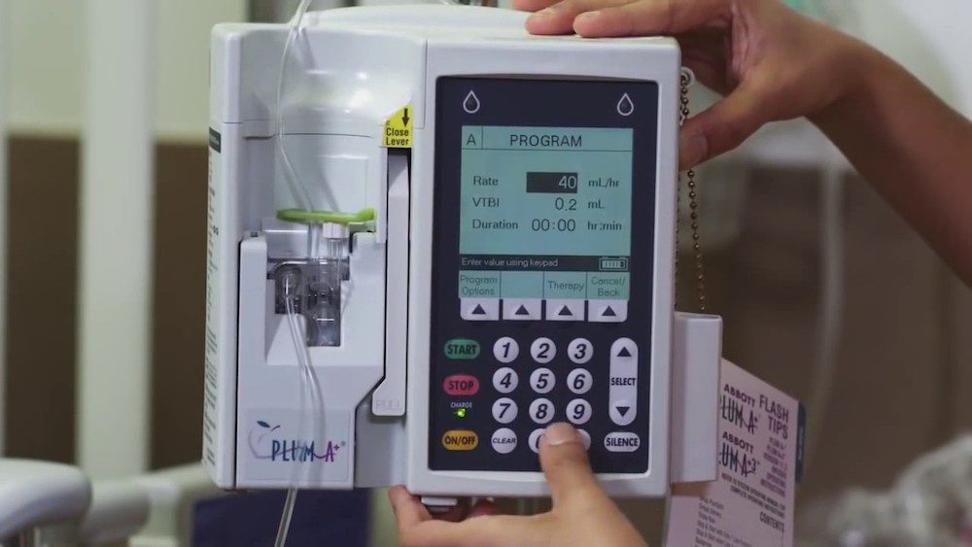
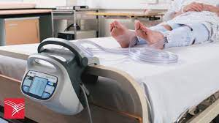
CONSIDERATIONS WHEN PREPROCESSING iEEG DATA
Environment is not as controlled as a typical recording environment (sound proof booth)
Background sounds
Where electrodes are located
How electrodes are plugged into amplifier is important for (re)-referencing
Sources of electrical noise
Aqusistion sampling rate is important if you want high frequency information
WIRED 2024

Slide 11
DIFFERENT TYPES OF iEEG ARTIFACTS
Motion artifact
Epileptiform activity
Chewing/jaw artifact
VNS artifact (vagus nerve stimulator)
WIRED 2024

Slide 12
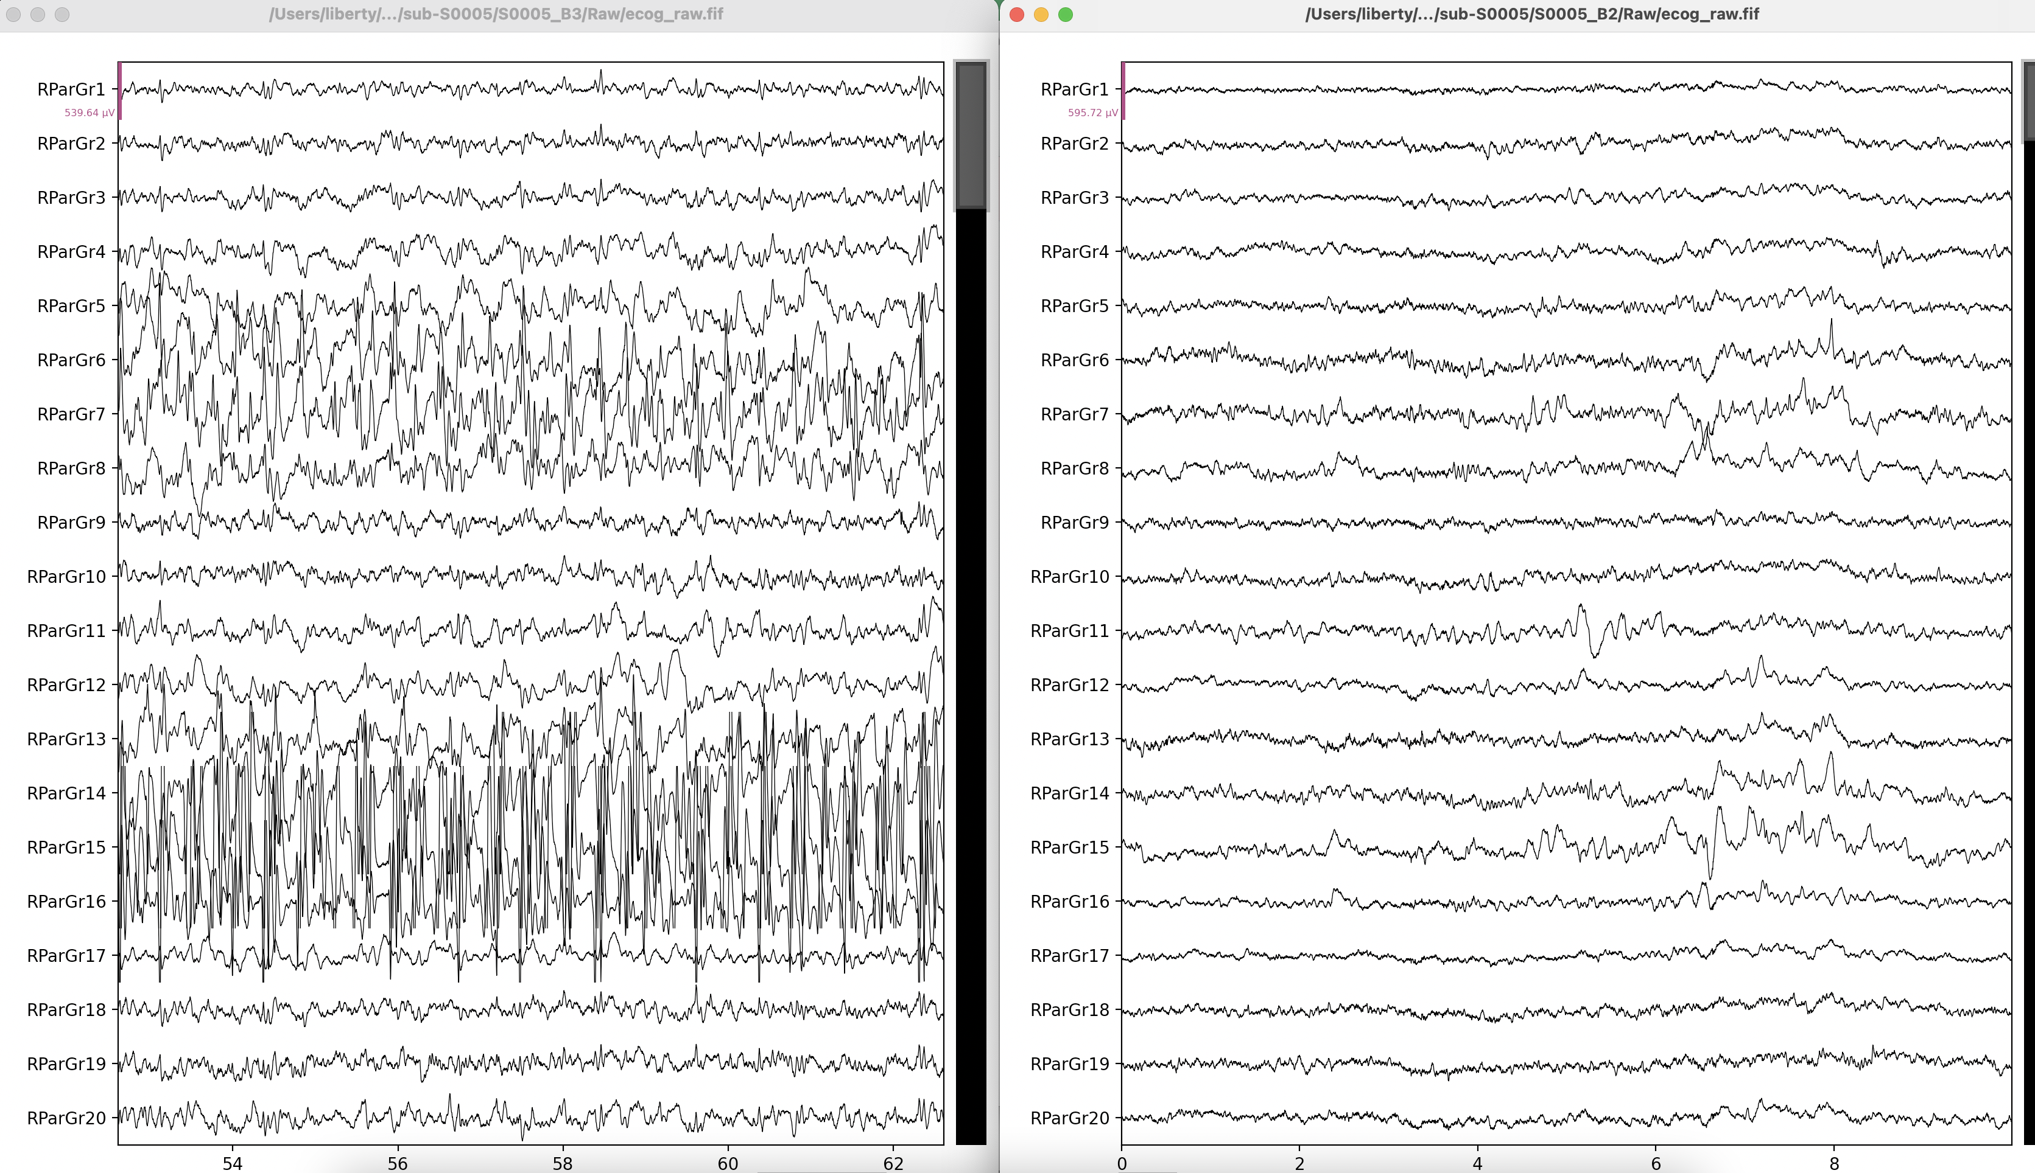
SEIZURE ACTIVITY (LEFT)
WIRED 2024

Slide 13
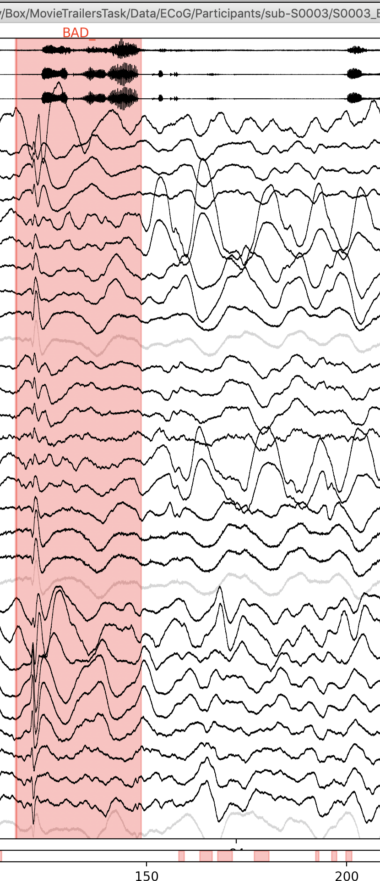
SPIKE WAVE
An example of an epileptiform artifact – fast spike followed by slow wave
WIRED 2024

Slide 14
iEEG TUTORIAL
We will load iEEG data with BIDS metadata
Plot power spectrum
Plot raw data and look for bad channels and artifacts
Convert to high-gamma analytic amplitude
Plot evoked data
WIRED 2024

Slide 15
iEEG TUTORIAL
WIRED 2024

